Slide 1
UNIT 5 REGISTERS AND COUNTERS
II YEAR
AIML, BDA

Slide 2
CONTENTS
Registers and Types of Registers
Serial In - Serial Out, Serial In - Parallel out , Parallel In - Serial Out, Parallel In - Parallel Out
Universal Shift Register
Applications of Shift Registers
Synchronous Counters Asynchronous Counters
Changing the Counter Modulus
Decade Counters
Presettable counters
Counter Design as a Synthesis problem
Seven segment Display and A Digital Clock.
D/A Conversion
Types of D/A Converters
A/D Conversion
Types of A/D conversion

Slide 3
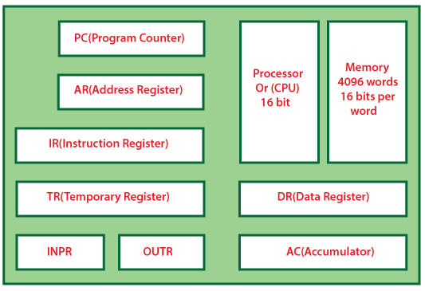
Registers and Types of Registers
Flip-flop is a 1bit memory cell which can be used for storing the digital data.
To increase the storage capacity in terms of number of bits, we have to use a group of flip-flop.
Such a group of flip-flop is known as a Register.
The n-bit register will consist of n number of flip-flop and it is capable of storing an n-bit word.

Slide 4

Registers and Types of Registers
The binary data in a register can be moved within the register from one flip-flop to another.
The registers that allow such data transfers are called as shift registers.
There are four mode of operations of a shift register.
Serial Input Serial Output
Serial Input Parallel Output
Parallel Input Serial Output
Parallel Input Parallel Output

Slide 5
Serial In - Serial Out
In "Serial Input Serial Output", the data is shifted "IN" or "OUT" serially. In SISO, a single bit is shifted at a time in either right or left direction under clock control.
Initially, all the flip-flops are set in "reset" condition i.e. Y₃ = Y₂ = Y₁ = Y₀ = 0. If we pass the binary number 1111, the LSB bit of the number is applied first to the Din bit.
The D3 input of the third flip flop, i.e., FF-3, is directly connected to the serial data input D3.
The output Y₃ is passed to the data input d₂ of the next flip flop.
This process remains the same for the remaining flip flops. The block diagram of the "Serial IN Serial OUT" is given below.

Slide 6
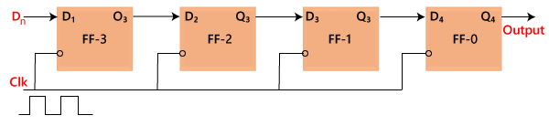
Serial In - Serial Out

Slide 7
Serial Input Parallel Output
In the "Serial IN Parallel OUT" shift register, the data is passed serially to the flip flop, and outputs are fetched in a parallel way.
The data is passed bit by bit in the register, and the output remains disabled until the data is not passed to the data input.
When the data is passed to the register, the outputs are enabled, and the flip flops contain their return value
Below is the block diagram of the 4-bit serial in the parallel-out shift register.
The circuit having four D flip-flops contains a clear and clock signal to reset these four flip flops. In SIPO, the input of the second flip flop is the output of the first flip flop, and so on.
The same clock signal is applied to each flip flop since the flip flops synchronize each other. The parallel outputs are used for communication.

Slide 8
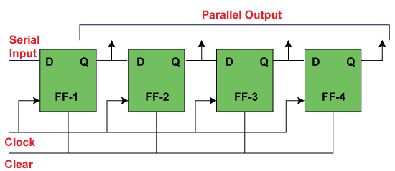
Serial Input Parallel Output

Slide 9
Parallel Input Serial Output
In the "Parallel IN Serial OUT" register, the data is entered in a parallel way, and the outcome comes serially. A four-bit "Parallel IN Serial OUT" register is designed below.
The input of the flip flop is the output of the previous Flip Flop.
The input and outputs are connected through the combinational circuit.
Through this combinational circuit, the binary input B₀, B₁, B₂, B₃ are passed.
The shift mode and the load mode are the two modes in which the "PISO" circuit works.

Slide 10
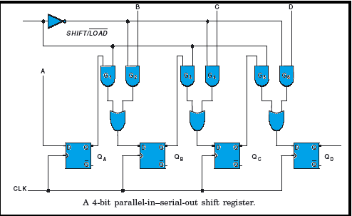
Parallel Input Serial Output

Slide 11
Parallel Input Parallel Output
In "Parallel IN Parallel OUT", the inputs and the outputs come in a parallel way in the register.
The inputs A₀, A₁, A₂, and A₃, are directly passed to the data inputs D₀, D₁, D₂, and D₃ of the respective flip flop.
The bits of the binary input is loaded to the flip flops when the negative clock edge is applied.
The clock pulse is required for loading all the bits. At the output side, the loaded bits appear.

Slide 12
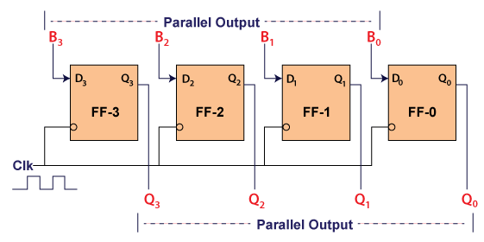
Parallel Input Parallel Output

Slide 13
Universal Shift Registers
A register that can store the data and /shifts the data towards the right and left along with the parallel load capability is known as a universal shift register.
It can be used to perform input/output operations in both serial and parallel modes.
Unidirectional shift registers and bidirectional shift registers are combined together to get the design of the universal shift register.
It is also known as a parallel-in-parallel-out shift register or shift register with the parallel load.
Universal shift registers are capable of performing 3 operations as listed below.
Parallel load operation – stores the data in parallel as well as the data in parallel
Shift left operation – stores the data and transfers the data shifting towards left in the serial path
Shift right operation – stores the data and transfers the data by shifting towards right in the serial path.
Hence, Universal shift registers can perform input/output operations with both serial and parallel loads.

Slide 14
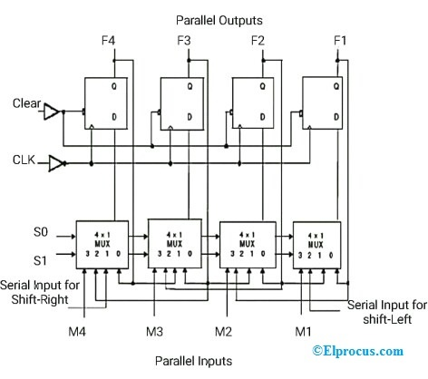
Universal Shift Registers

Slide 15
Applications of Shift Registers
Following are the applications of shift registers.
Shift register is used as Parallel to serial converter, which converts the parallel data into serial data. It is utilized at the transmitter section after Analog to Digital Converter ADC block.
Shift register is used as Serial to parallel converter, which converts the serial data into parallel data. It is utilized at the receiver section before Digital to Analog Converter DAC block.
Shift register along with some additional gates generate the sequence of zeros and ones. Hence, it is used as sequence generator.
Shift registers are also used as counters. There are two types of counters based on the type of output from right most D flip-flop is connected to the serial input. Those are Ring counter and Johnson Ring counter.

Slide 16
CONTENTS
Registers and Types of Registers
Serial In - Serial Out, Serial In - Parallel out , Parallel In - Serial Out, Parallel In - Parallel Out
Universal Shift Register
Applications of Shift Registers
Synchronous Counters Asynchronous Counters
Changing the Counter Modulus
Decade Counters
Presettable counters
Counter Design as a Synthesis problem
Seven segment Display and A Digital Clock.
D/A Conversion
Types of D/A Converters
A/D Conversion
Types of A/D conversion

Slide 17
Counter
Counter is a sequential circuit. A digital circuit which is used for a counting pulses is known counter. Counter is the widest application of flip-flops. It is a group of flip-flops with a clock signal applied. Counters are of two types.
Asynchronous or ripple counters.
Synchronous counters.
Modulus Counter (MOD-N Counter)
The 2-bit ripple counter is called as MOD-4 counter and 3-bit ripple counter is called as MOD-8 counter.
So in general, an n-bit ripple counter is called as modulo-N counter. Where, MOD number = 2^{n}.
Type of modulus
2-bit up or down (MOD-4)
3-bit up or down (MOD-8)
4-bit up or down (MOD-16)
Application of counters
Frequency counters
Digital clock
Time measurement
A to D converter
Frequency divider circuits
Digital triangular wave generator

Slide 18
Changing the Counter Modulus
MOD Counters are cascaded counter circuits which count to a set modulus value before resetting
Modulus Counters, or simply MOD counters, are defined based on the number of states that the counter will sequence through before returning back to its original value. For example, a 2-bit counter that counts from 00₂ to 11₂ in binary, that is 0 to 3 in decimal, has a modulus value of 4 ( 00 → 1 → 10 → 11, and return back to 00 ) so would therefore be called a modulo-4, or mod-4, counter. Note also that it has taken four clock pulses to get from 00 to 11.

Slide 19
